Slide 1
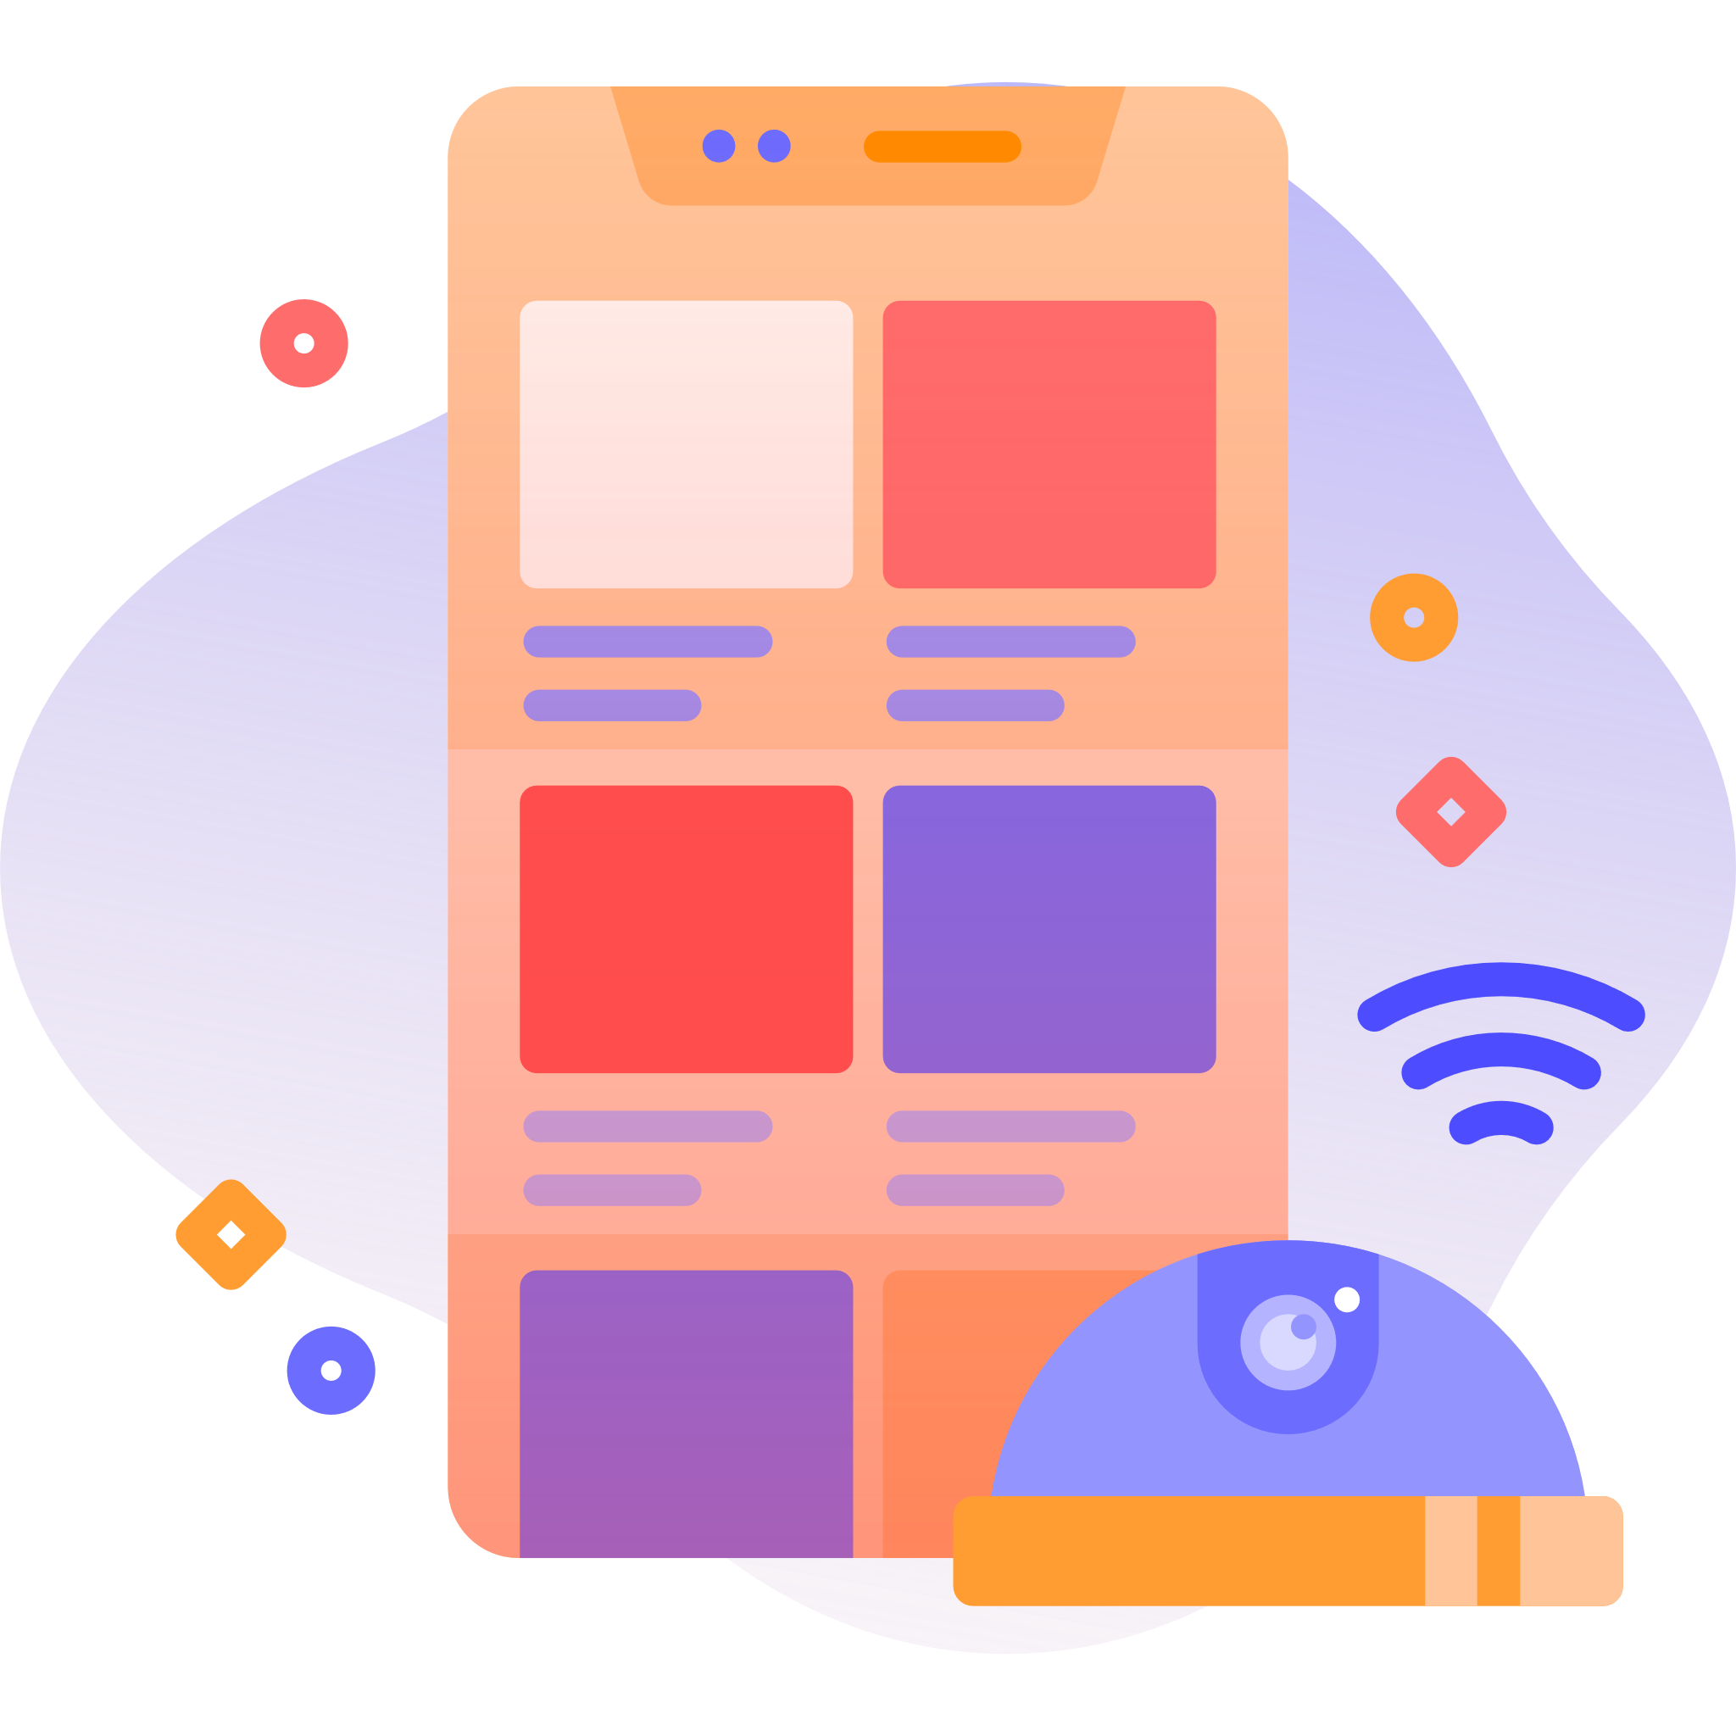
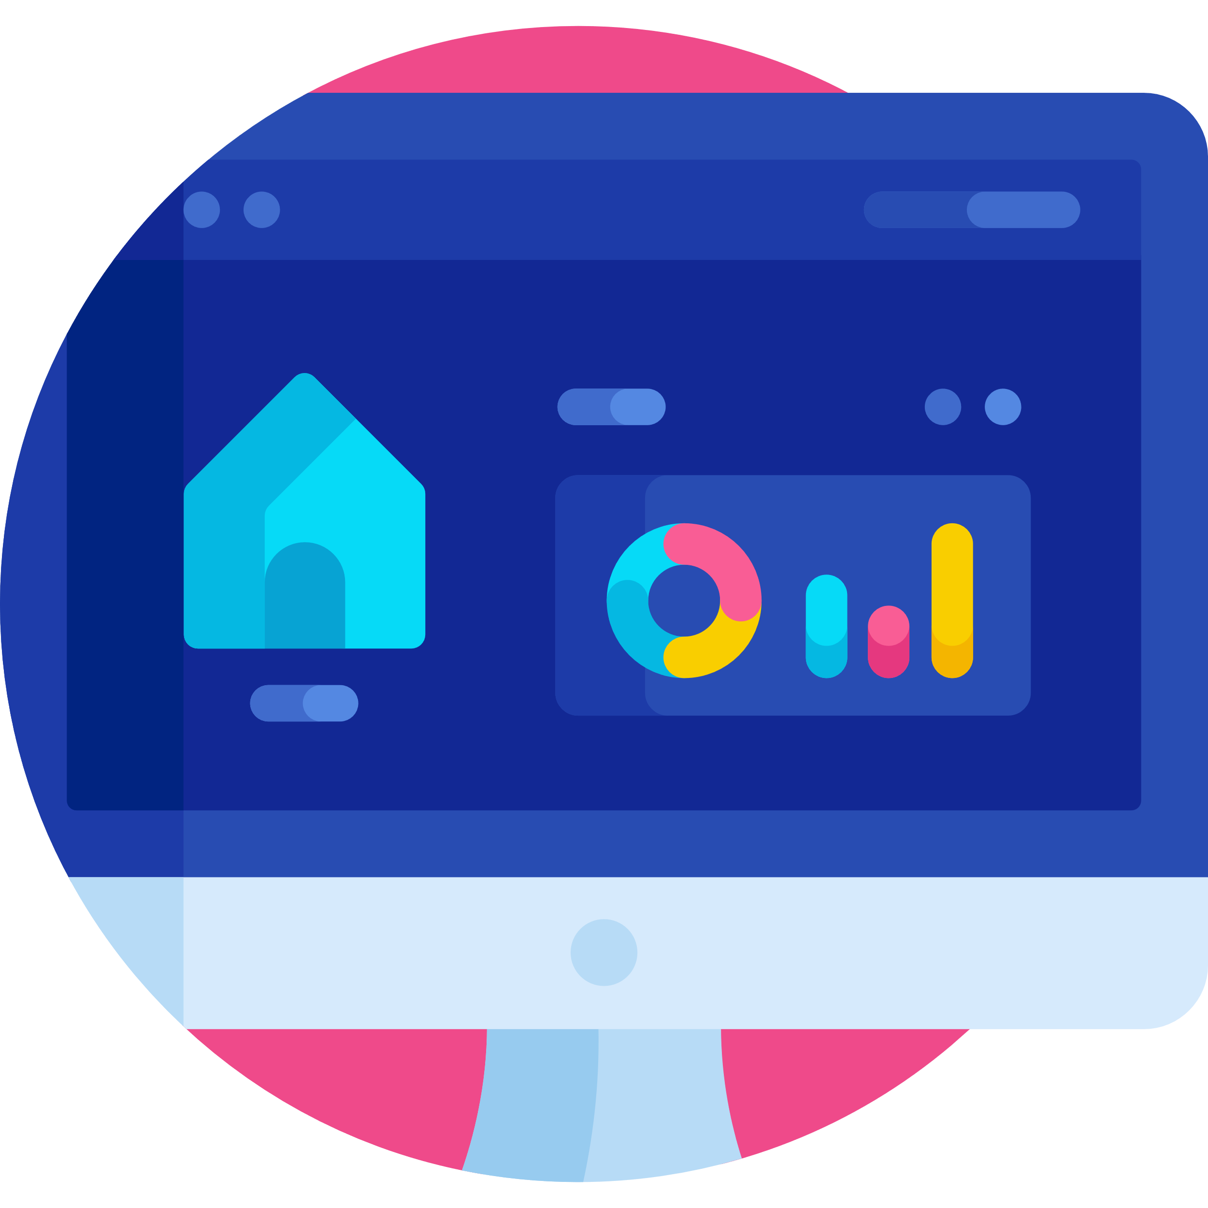
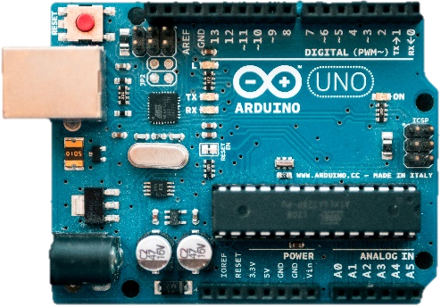
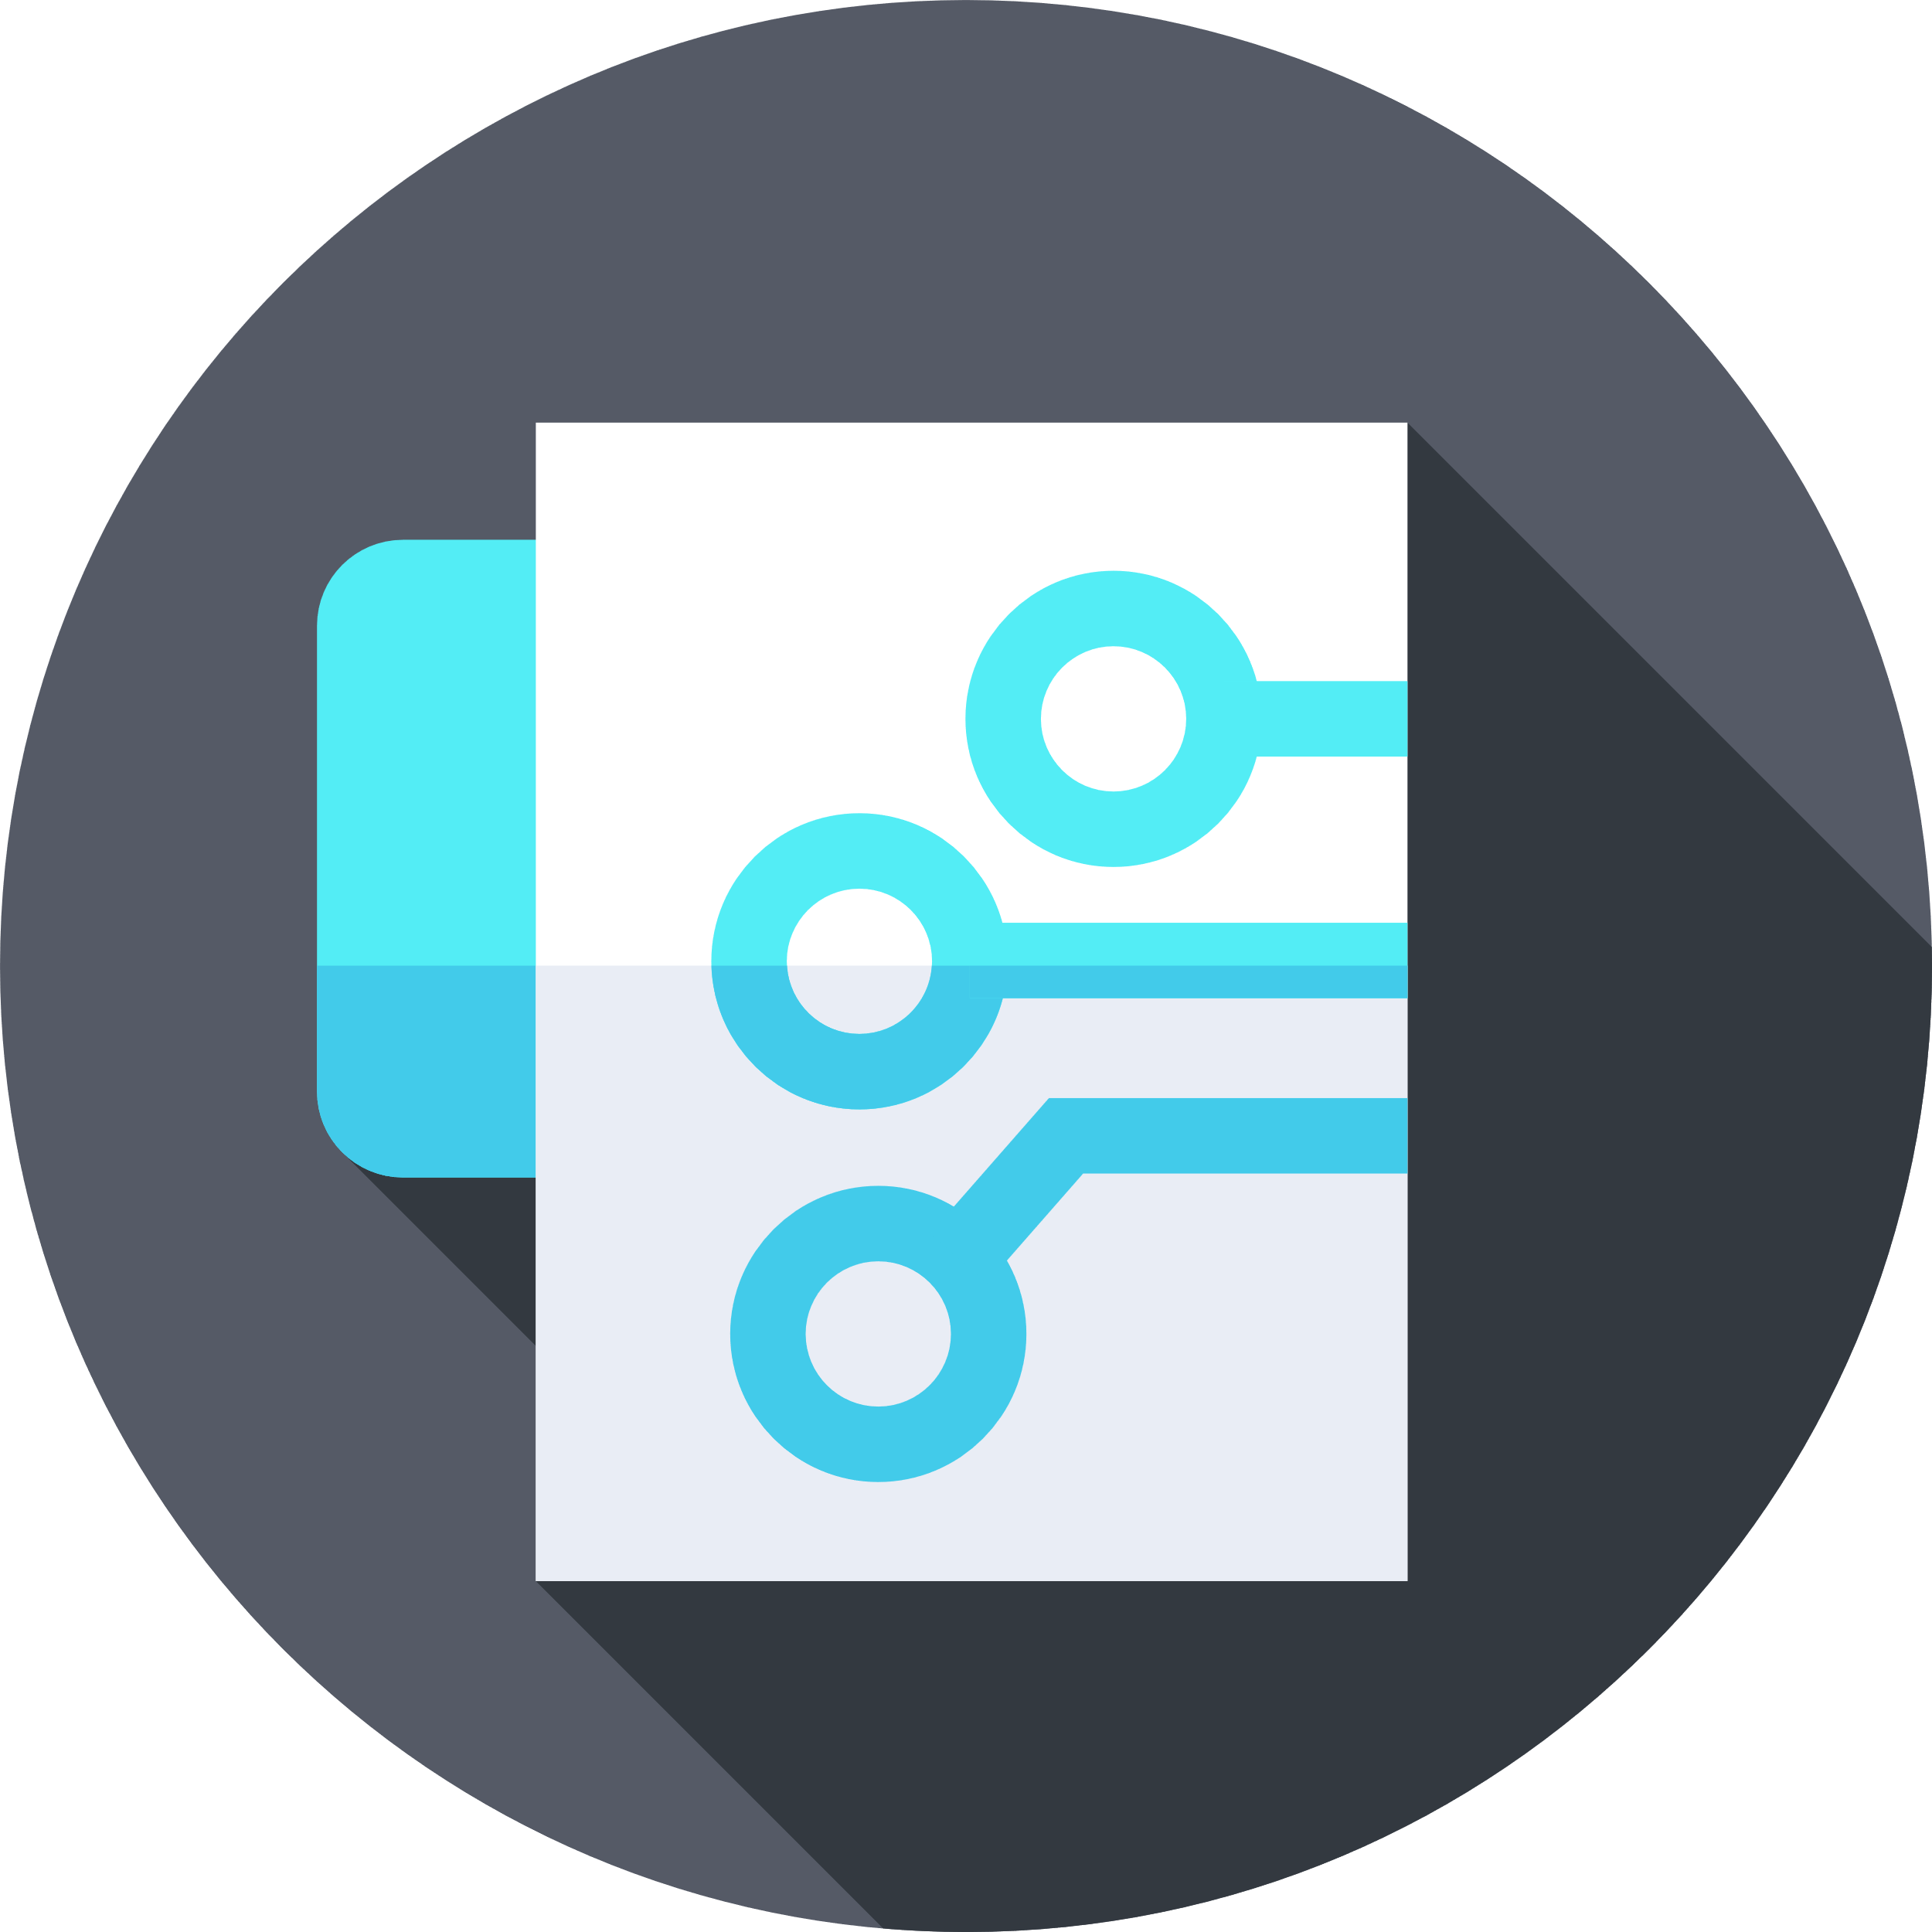
Internet
Internet
Of
Of
Things
Things
Instructor: Aman Singh

Slide 2
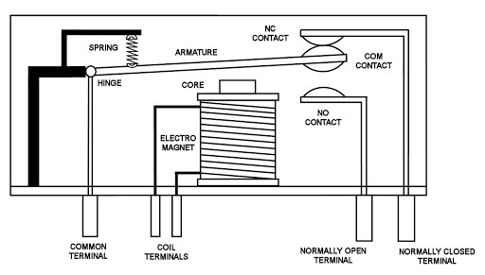
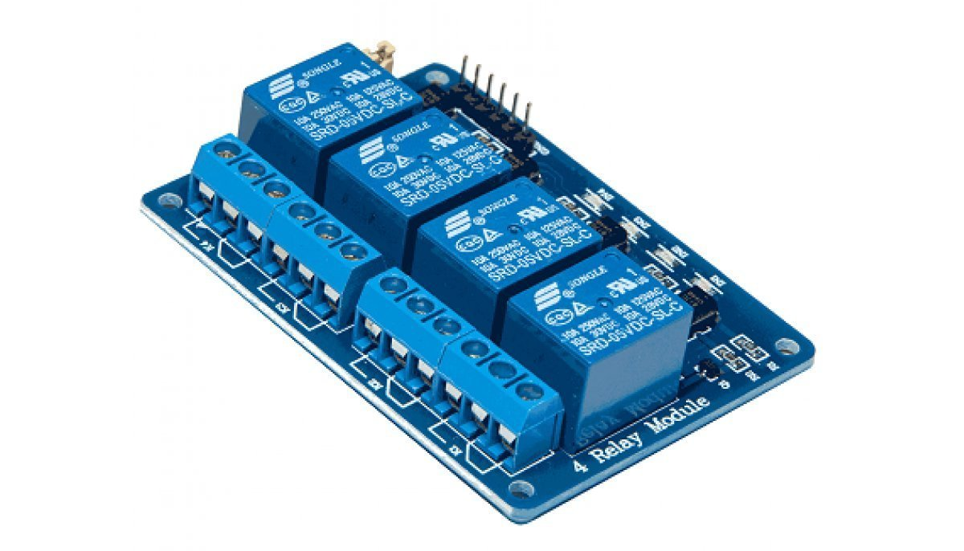
Relay

Slide 3
What is Cloud Computing?
Cloud computing is delivery of different services through the internet. These resources include tools and applications like data storage, servers, databases, networking, and software.
Rather than keeping files on a proprietary hard drive or local storage device, cloud-based storage makes it possible to save them to a remote database. As long as an electronic device has access to the web, it has access to the data and software programs to run it.
It is cost saving, increase productivity, speed and efficiency, performance and security.
Most of the businesses and startup today use cloud computing.

Slide 4
we do not store and
process data on air its just
someone else's computer

Slide 5
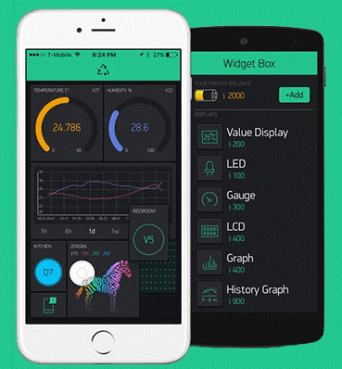



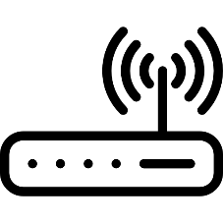
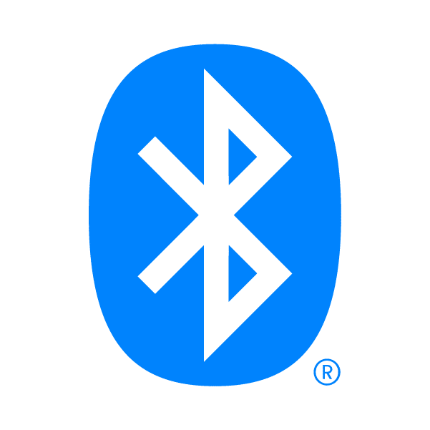

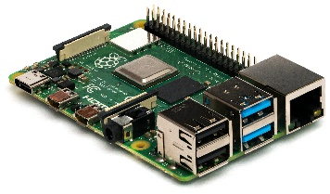
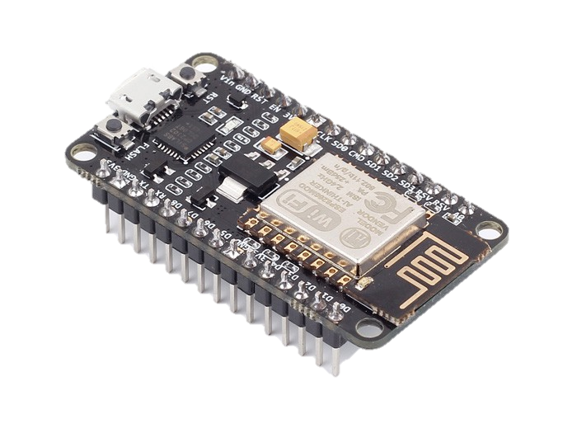
IoT Reference Architecture?
Application Layer or API Management
(Mobile APP, Dashboard, API Management)
Event Processing and Analytics Layer
(AWS IoT, Google Cloud Platform, Digital Ocean, Blynk)
Aggregation Layer
(HTTP Server, MQTT Broker, Gateway)
Communication Layer
(Bluetooth, Zigbee, WiFi)
Device Layer
(Node MCU, Raspberry Pi, Arduino, STM32 and sensors)

Slide 6
What is Blynk?
Blynk is a IoT cloud platform which helps you control, monitor and manage all of your IoT devices.
Blynk is an easy to use Platform, it provides you a set of Arduino Libraries form which you can create your program for Arduino.
These library helps to connect our IoT device to Blynk cloud Platform.
You can program with Blynk on any IoT device e.g. Arduino, ESP32, Raspberry Pi etc.
You can deploy your own Blynk server locally.
Blynk App contains widgets which helps us to visualize data and control our IoT device. If You are using Blynk cloud there will be a limitation on how much widgets you can add on your dashboard, so choose wisely.

Slide 7
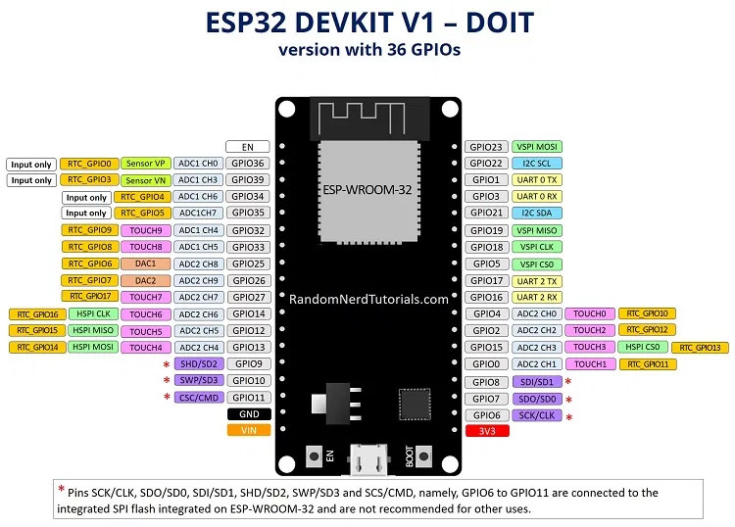

Slide 8
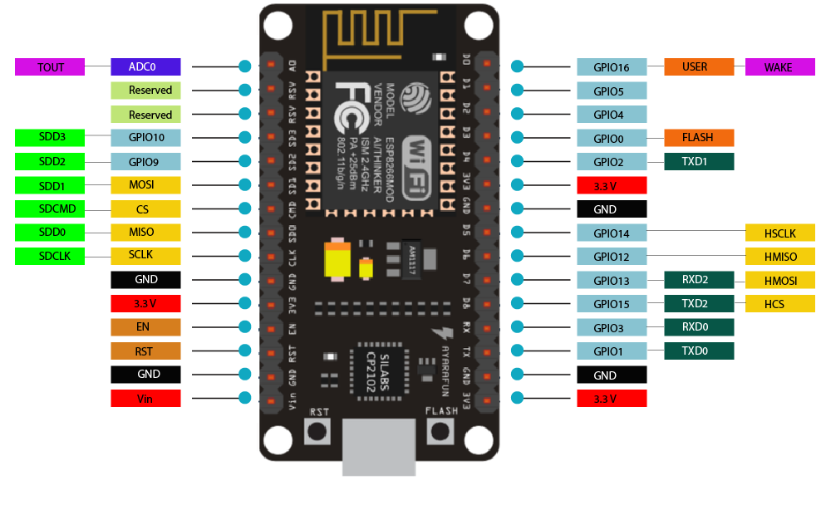
NodeMCU Pinout

Slide 9
Let’s Code
Working with Light Sensor (LDR)
Taking Digital inputs from push button
Controlling Brightness of LED with PWM
Working with Potentiometer

